Slide 1


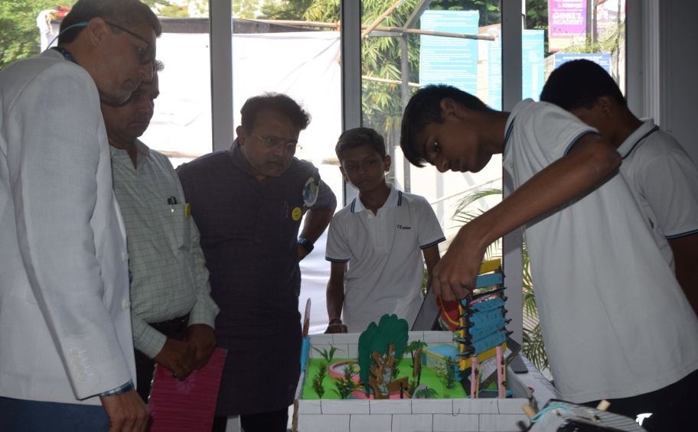
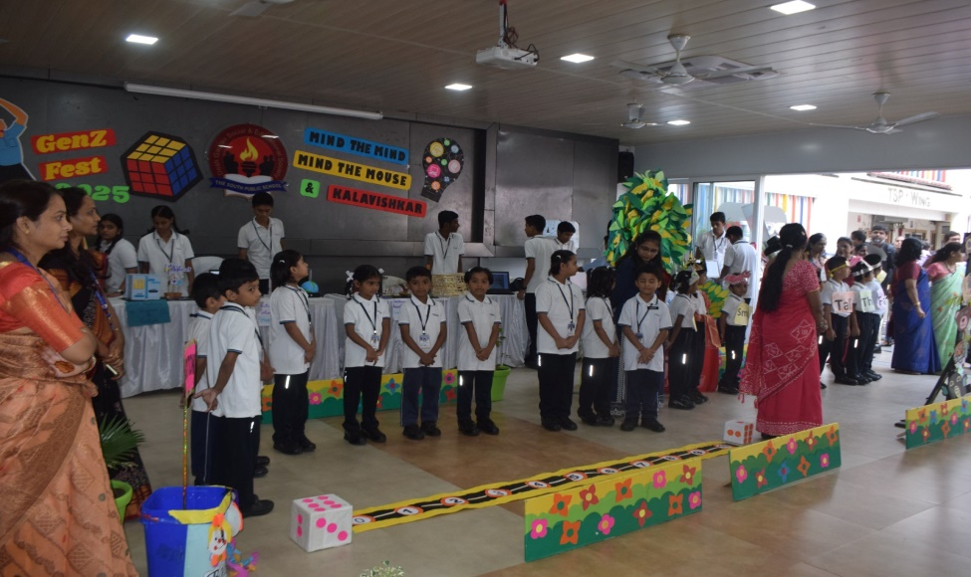
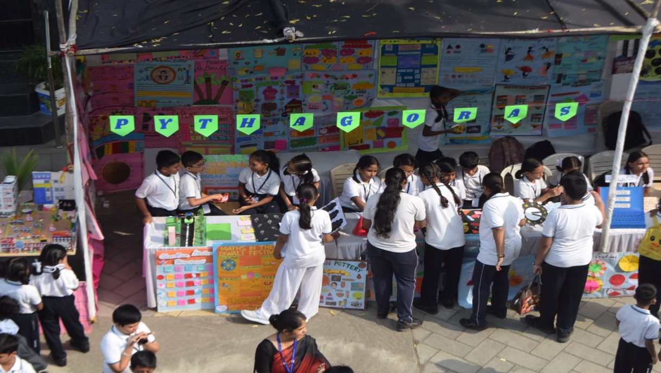
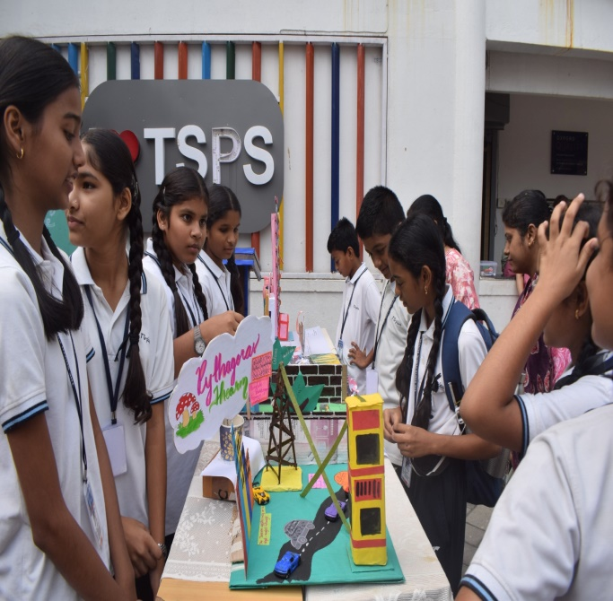
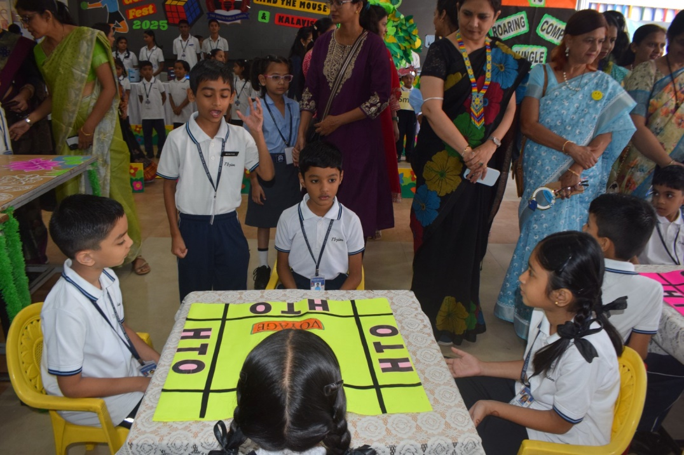
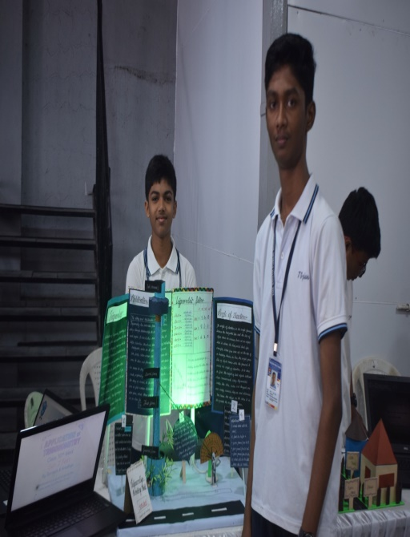
TSPS BYTES
September to December 2025

Slide 2


To build a solid foundation for the Educational, Mental, Physical, Spiritual growth in all walks of life for children who further become responsible, trustworthy and reliable citizens of society.
Our
Vision
We believe that every individual child is creative and enthusiastic;
hence, our mission is to develop these youngsters with active and
creative minds with a sense of understanding and compassion for
others, with responsibility to create love and friendship within the
countrymen and with an aim to develop their holistic, spiritual,
moral, emotional and physical strengths, leadership and personality
development skills in TS-pians
Our
Mission
The objective of the school is prepare youth with dynamic personalities,
having a sense of adventure in them, humane in all their dealings (and
just not intelligent robots) , and lastly who are cultured and aware of their
heritage.
The students shall value the western concepts of science and technology,
however, they shall have their roots in the Indian culture and Indian
ethos with discipline, leadership, co-existence, social adjacent,
hardwork, etc the need of the day- “SURVIVAL OF THE FITTEST…”
Our
Motto

Slide 3

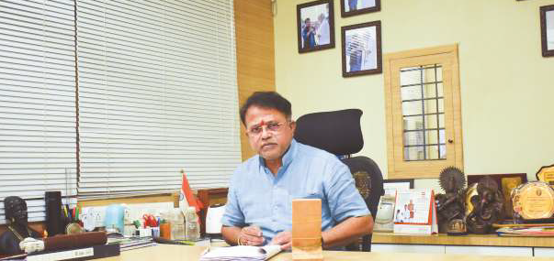
From the Director’s Desk
"Wisdom begins in wonder." – Socrates
Dear Students, Parents, and Educators,
As we embark on a new journey, I'm thrilled to share with you the essence of our school's philosophy. At TSPS, we believe that education is not just about academics, but about nurturing the whole child. Our mantra of "Khana, Khelna, Gana, Padhana, and Sona" beautifully encapsulates the essence of holistic education. By focusing on these five key aspects, we aim to shape well-rounded individuals who are equipped to face the challenges of the future.

Slide 4
From the Director’s Desk (Contd.)
Nourishing the Body and Soul
Our state-of-the-art auditorium is a testament to our commitment to providing a platform for students to showcase their talents. This magnificent structure has become the heartbeat of our school, hosting a variety of events and performances that celebrate the creativity and diversity of our students. From cultural festivals to talent shows, our auditorium has become a hub of activity, fostering a sense of community and belonging among our students.
Accommodating Growth
As our school continues to thrive, we've introduced two shifts for Senior and Junior wings, enabling us to accommodate our growing student body. This development ensures that each child receives personalized attention, allowing them to reach their full potential. Our dedicated team of educators is committed to providing a nurturing environment that supports the unique needs and aspirations of each student.

Slide 5
From the Director’s Desk (Contd.)
A Culture of Excellence
At TSPS, we're driven by a passion for excellence and a relentless pursuit of innovation. Our goal is to create an ecosystem that inspires and supports our students' growth, empowering them to become confident, creative, and compassionate individuals. As we continue on this journey, I invite you to join us in fostering a culture of excellence that celebrates the unique talents and abilities of each student.
Warm Regards
Shri. Deaven Dasture
Director, TSPS

Slide 6
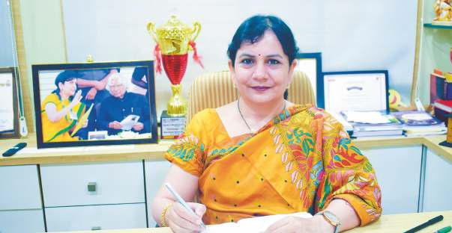
From the Principal’s Desk
"Education is the passport to the future, for tomorrow belongs to those who prepare for it today.“
- Malcolm X
As we embark on a new academic year, I'm thrilled to introduce our e-magazine, "TSPS Bytes" for the second academic. session This digital publication showcases the creativity, innovation, and dedication of our students and educators. At The South Public School, Omkar Nagar, we believe in providing holistic education that prepares students for the challenges of the future.

Slide 7
From the Principal’s Desk (Contd.)
Our Vision
We're committed to fostering a dynamic and excellent institution that nurtures young minds. Our passionate team of educators strives to make learning an enjoyable and enriching experience. With a focus on academic excellence and holistic development, we aim to equip our students with the skills and knowledge necessary to succeed in an ever-changing world.
New Infrastructure, New Era
Our school has taken a significant leap forward with the introduction of new infrastructure, catapulting us into a new era of education. With two shifts accommodating both senior and junior wings, we're witnessing a surge in popularity amongst Nagpurians, establishing ourselves as an innovation hub. Our state-of-the-art facilities provide an ideal environment for students to explore, learn, and grow.
!

Slide 8
From the Principal’s Desk (Contd.)
TSPS Bytes: A Platform for Creativity
This e-magazine is a testament to our commitment to nurturing creativity and innovation. We've curated the best moments and trivia from our school's journey, showcasing the talents of our students and educators. With "TSPS Bytes," we aim to share our story, inspire, and motivate our community.
Wishing You a Bright Future
As we begin this new academic year, I wish each and every one of you a bright and successful year ahead. May this e-magazine inspire you to reach new heights and explore your passions.
Happy Reading!

Slide 9
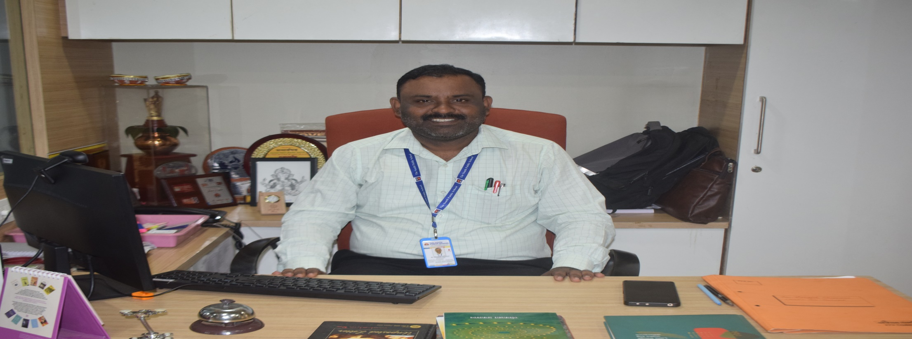
From the Vice- Principal’s Desk
"The purpose of education is to replace an empty mind with an open one.” - Malcolm Forbes
At The South Public School, we believe that education is a journey of discovery, growth, and empowerment. As we guide our students through the challenges of learning, we recognize the importance of nurturing their curiosity, creativity, and individuality.
A Commitment to Excellence
In our second year as a CBSE institution, we've excelled in various spheres, earning laurels and establishing ourselves as a reputable school in Nagpur. Our two-shift system is a testament to our growing popularity, catering to the increasing demand for quality education. We've created a dynamic learning environment that fosters academic excellence, creativity, and social responsibility.

Slide 10
From the Vice- Principal’s Desk (Contd.)
Our Philosophy
We believe that every individual has the potential to make a positive impact in the world. Our philosophy is centered around empowering students to be lifelong learners, who:
- Boldly chase their dreams
Persevere in the face of challenges
Believe in themselves and their abilities
Strive for excellence and continuous improvement
Showcasing Our Journey
The TSPS Bytes e-Magazine is a reflection of our commitment to excellence and our passion for learning. This digital publication showcases the myriad activities, achievements, and talents of our students and educators. We're proud to share our journey with you and inspire others to embark on their own path of discovery and growth.
Wishing You Success
As we continue on this journey, I wish our students, parents, and educators all the best. May this e-magazine inspire you to reach new heights and pursue your passions with courage and conviction.
Best regards,
Mr. Mangesh Chinewar
Vice Principal, The South Public School, Nagpur

Slide 11
FROM THE EDITORIAL TEAM’S DESK
Welcome to TSPS Bytes 2.0!
"The art of writing is the art of discovering what you believe."
- Gustave Flaubert
We're delighted to announce that TSPS Bytes, The South Public School's flagship e-magazine, is successfully continuing into its second year! Building on the success of our first session, which saw four editions of the magazine, we're excited to share new stories, articles, and features with our readers.
A Reflection of Our Community
In this new session, we'll continue to showcase the vibrant spirit of our school community through a diverse range of content. From academic achievements to creative pursuits, we'll highlight the talents and experiences of our students, teachers, and alumni. Our goal is to provide a platform for our community to share their ideas, opinions, and perspectives.
A Labour of Love
We'd like to thank our contributors, well-wishers, and readers for their support and enthusiasm. We're proud to continue this journey and look forward to sharing more exciting content with you.
Happy Reading!
The Editorial Team, TSPS Bytes

Slide 12



Editorial Team
From Left to Right : Ms. Anupama D’souza, Ms. Anjali Deshpande Ms. Shalakh Joshi, Ms. Vaishali Deshpande, Ms. Deepali Motghare, Ms. Priyanka Vijayvargiy, Ms. Deepali Wanjari, Ms. Shilpa Nanadanpawar,

Slide 13


Departmental Spotlights

Slide 14
Hindi
Maths (Mind the Mind)
IT ( Mind the Mouse)
Music & Art ( Kalavishkar)

Slide 15


Hindi
DEPARTMENT

Slide 16

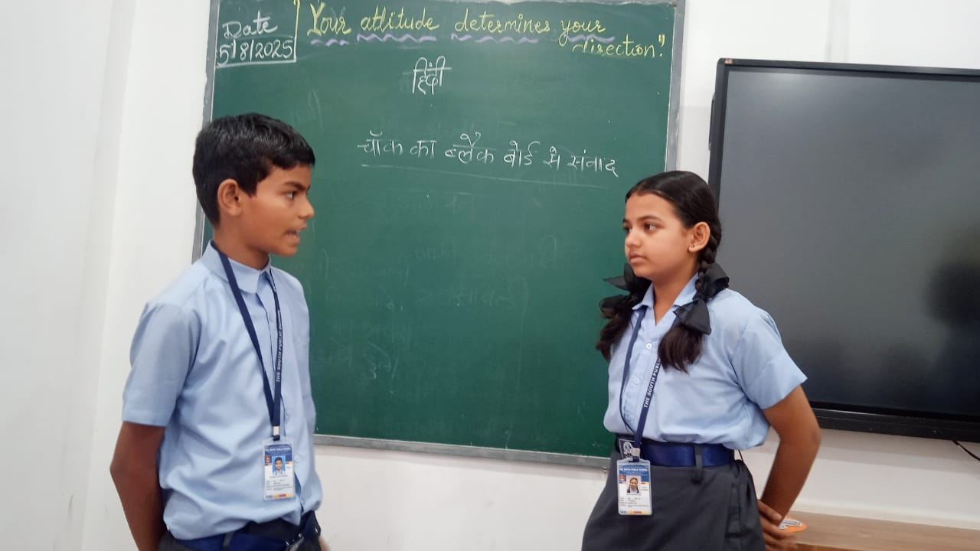
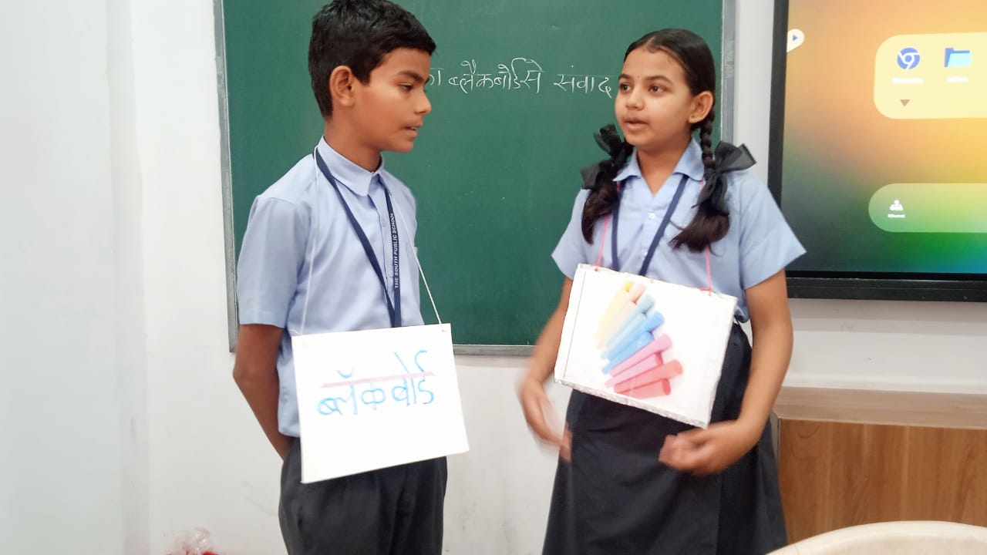
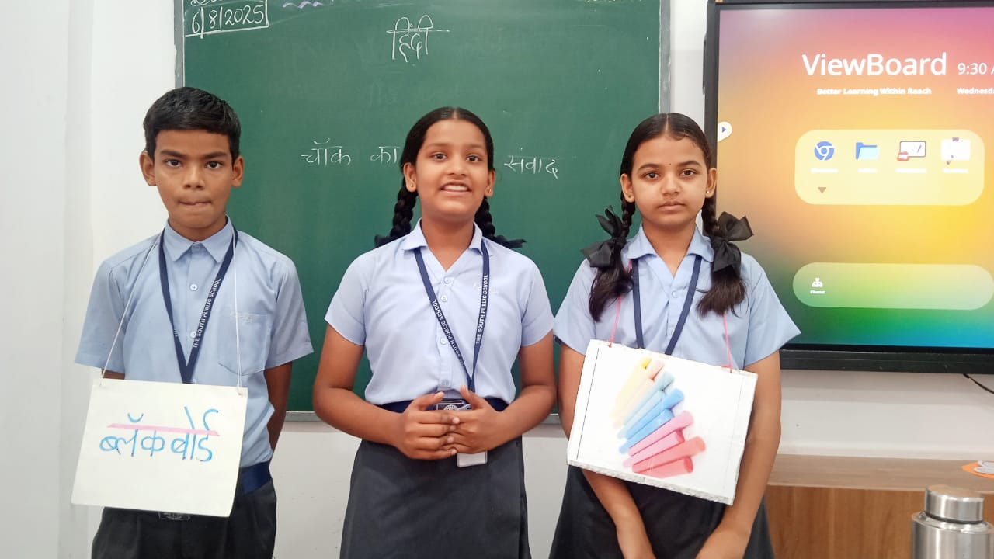
क्लास गतिविधियाँ

Slide 17
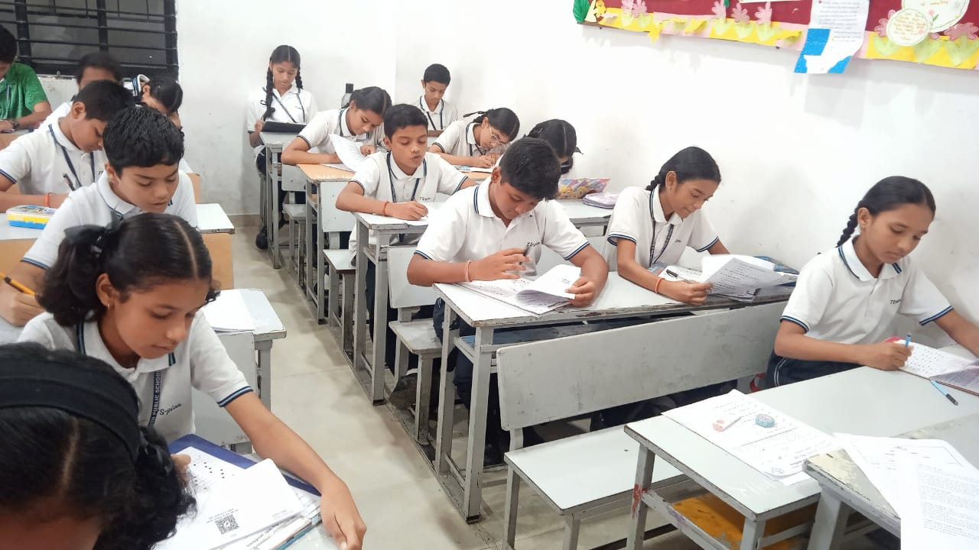
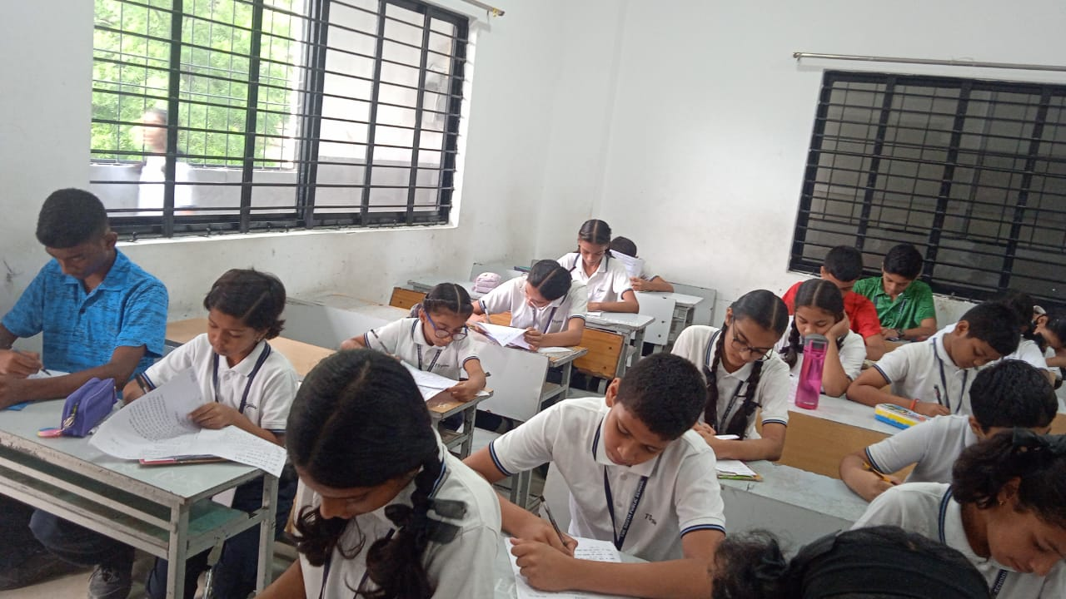
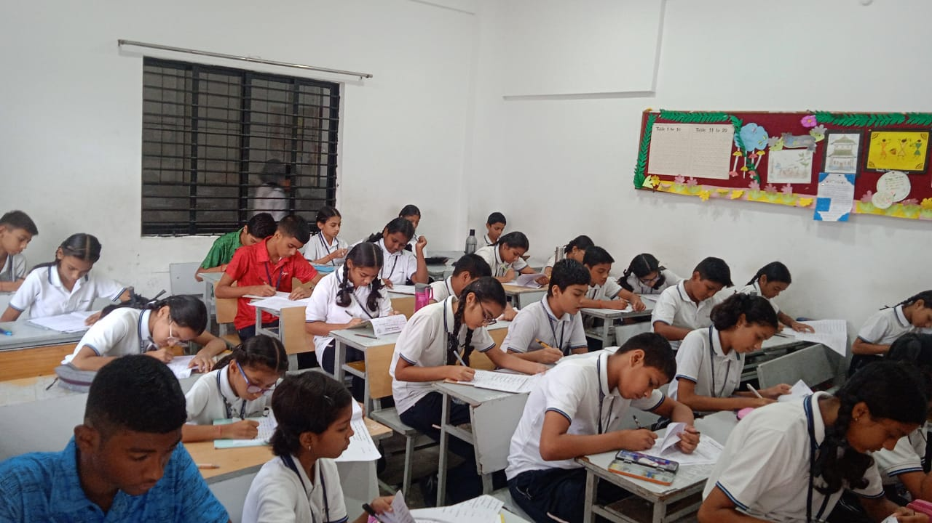
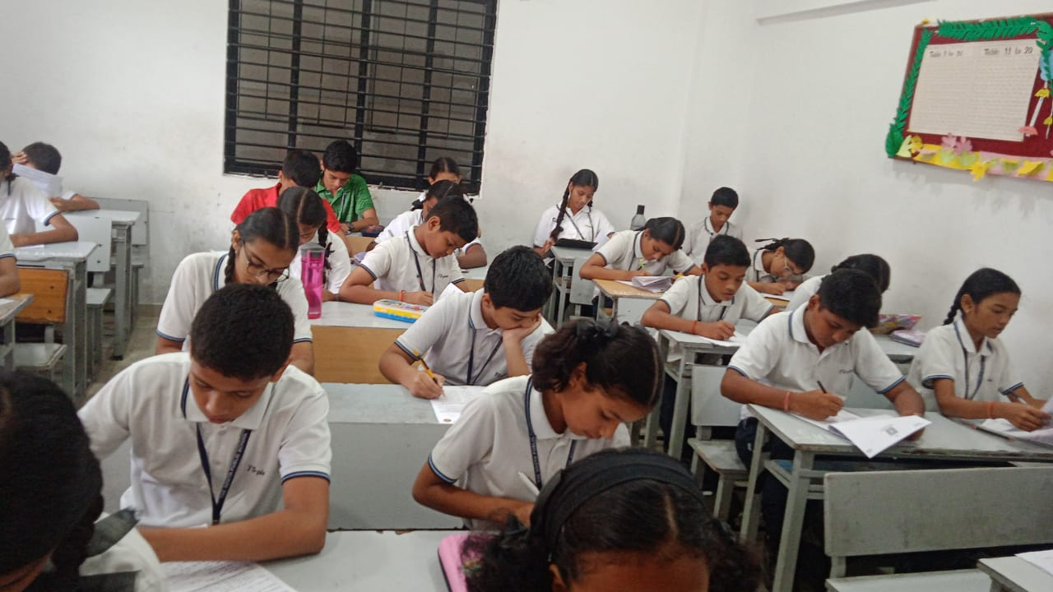
हिंदी ओलिंपियाड परीक्षा का आयोजन

Slide 18
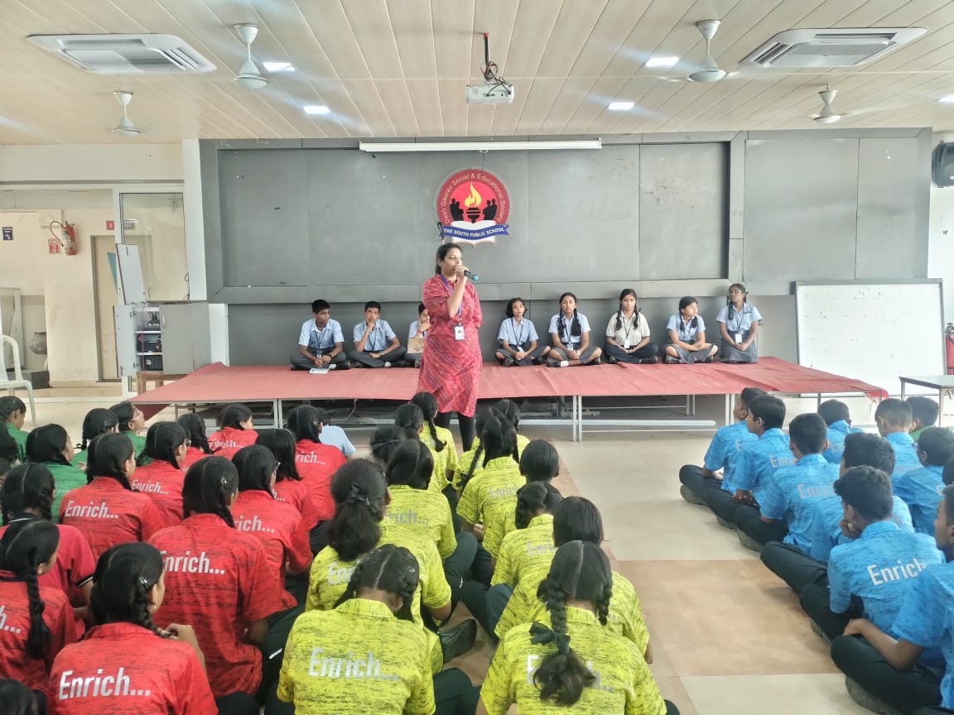
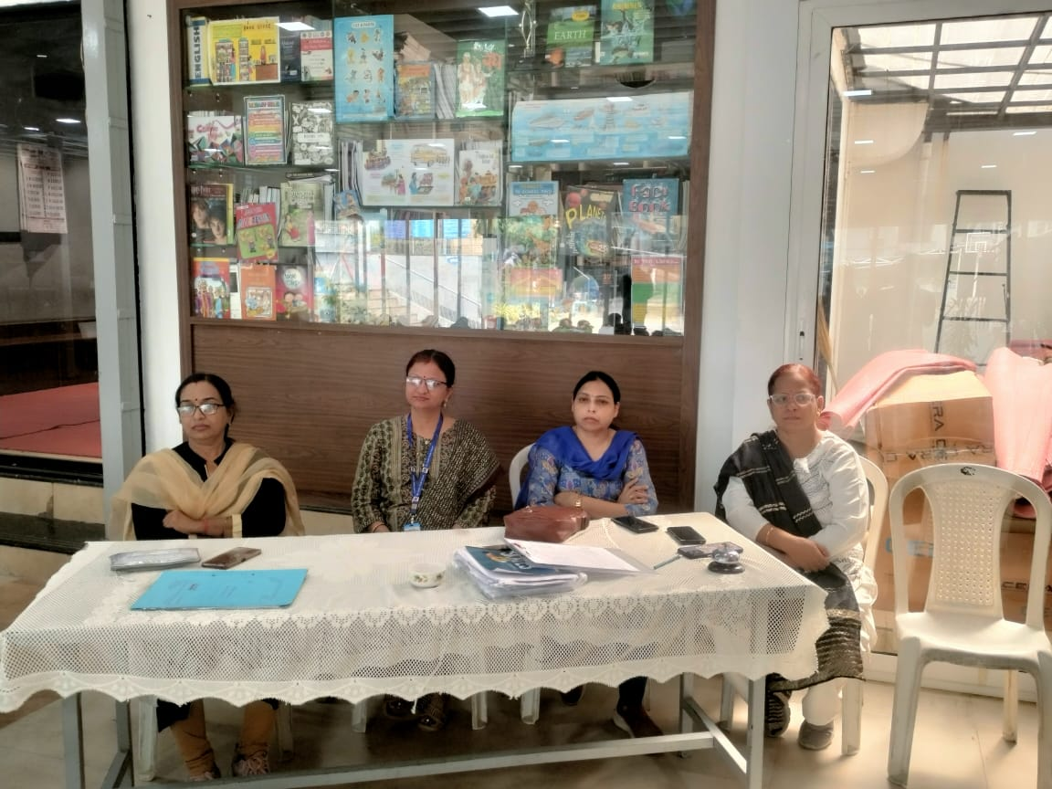
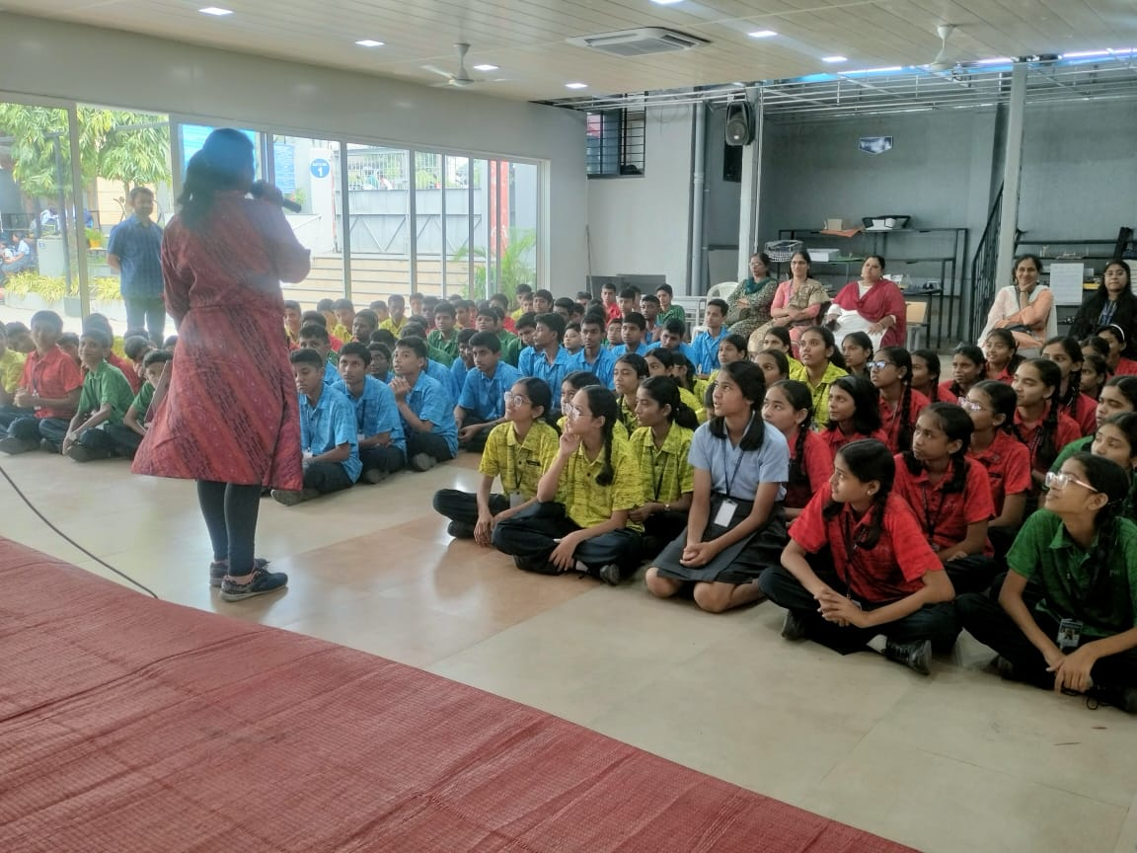
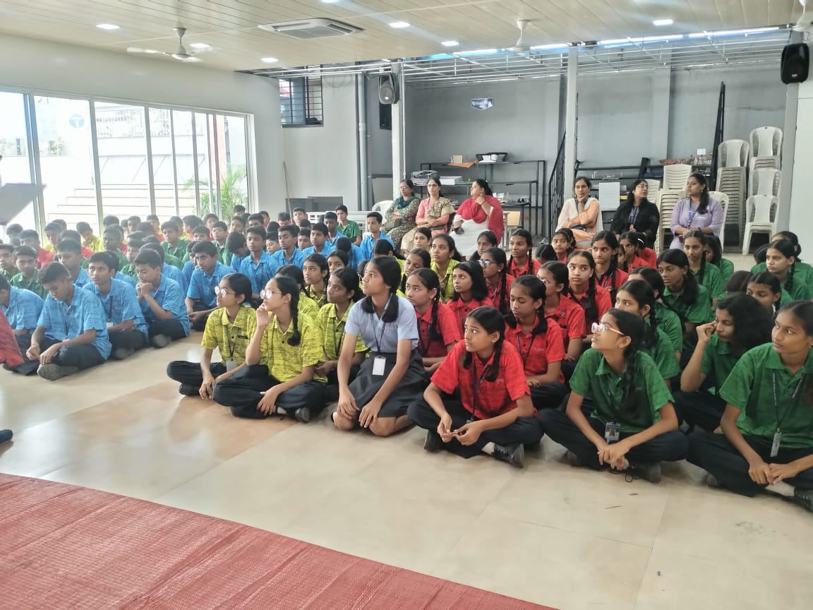
हिंदी एक्सटेम्पोर प्रतियोगिता

Slide 19
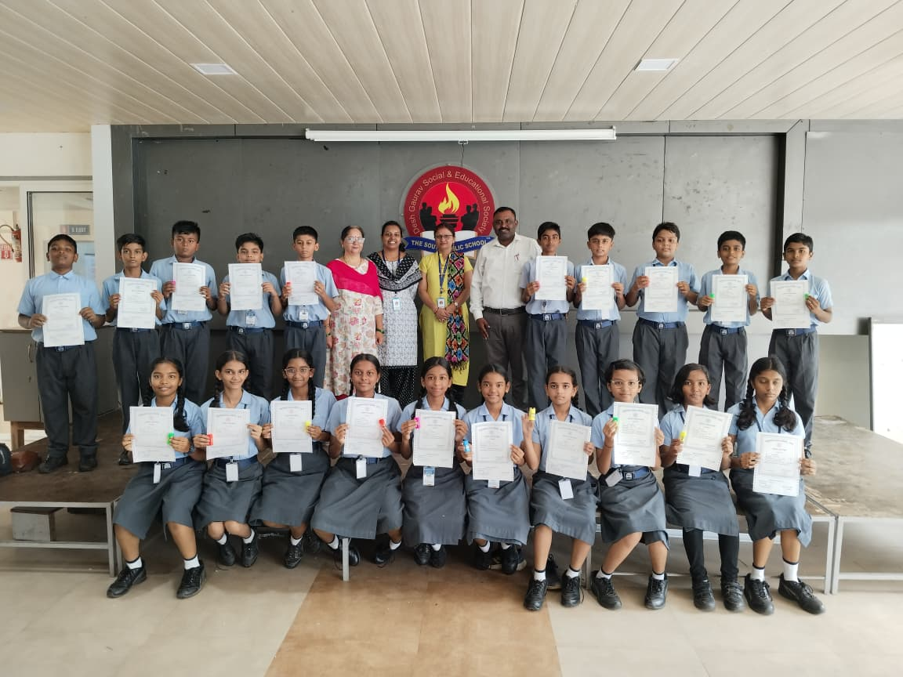
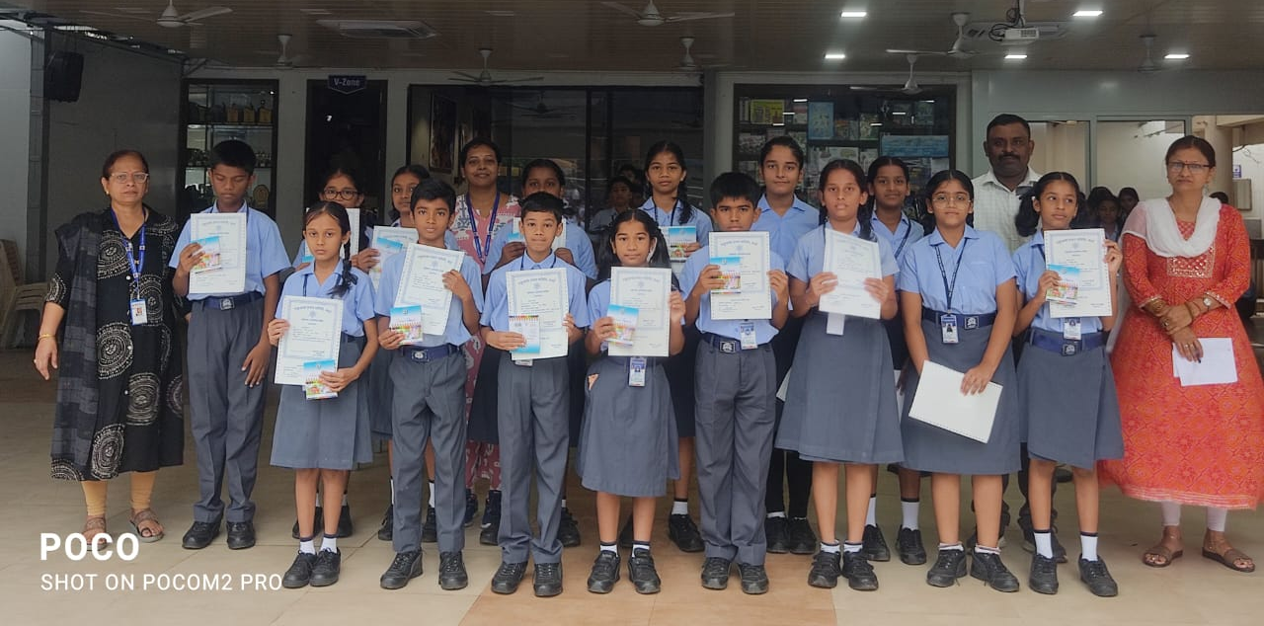
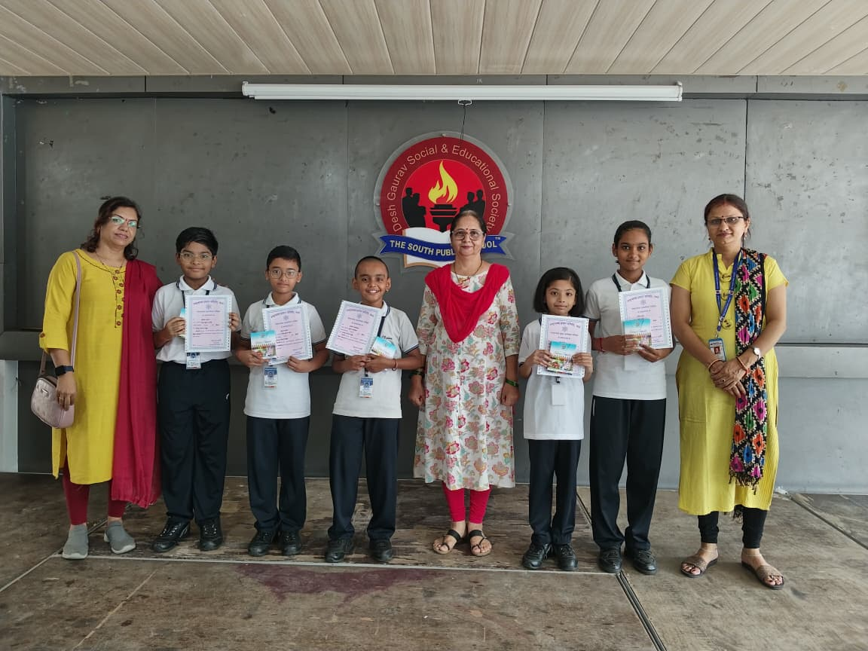
प्रमाणपत्र वितरण

Slide 20

SPECIAL DAYS
HINDI SAPTAH

Slide 21

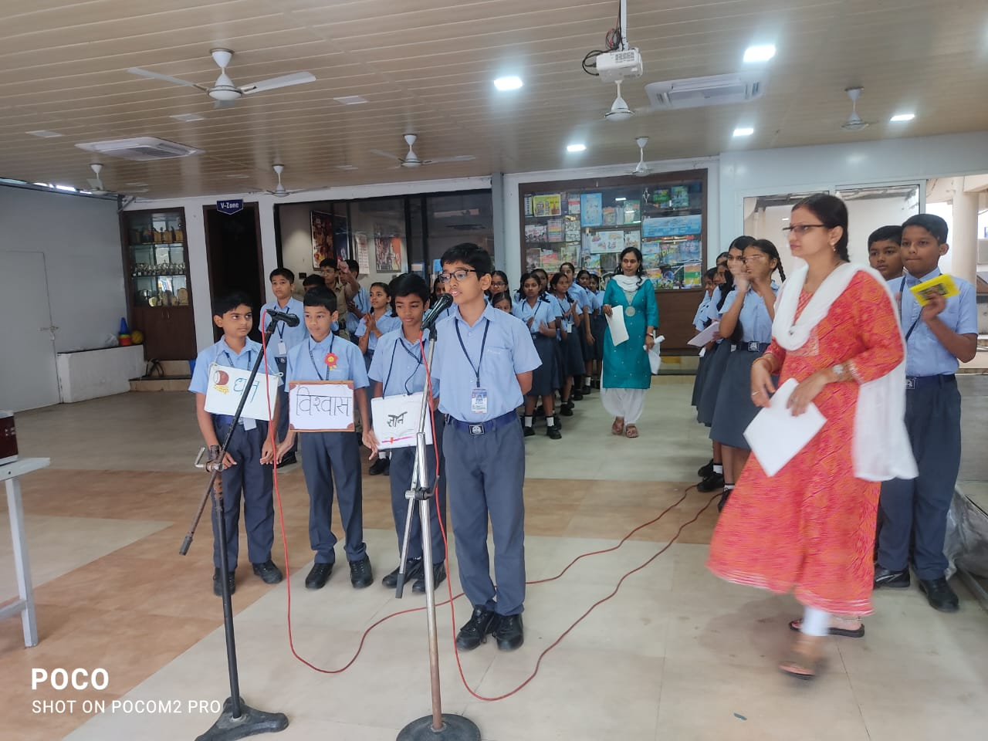
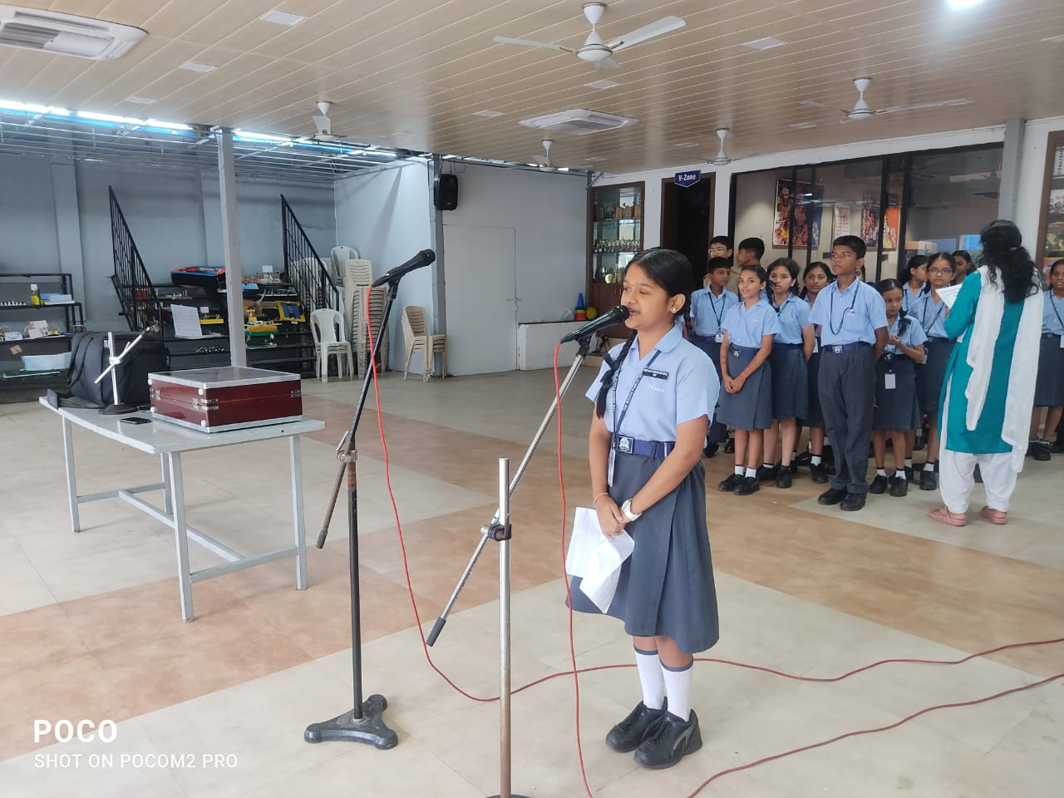
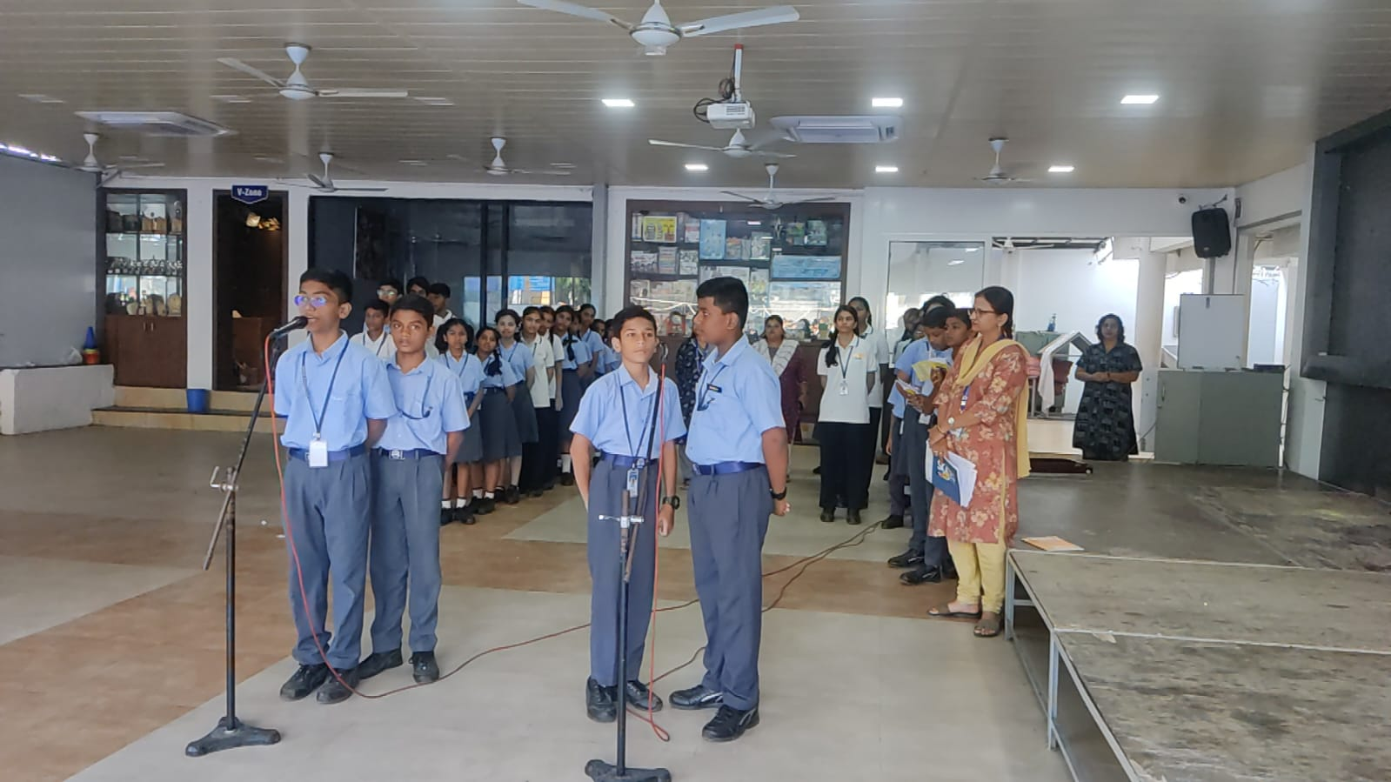
SPECIAL DAYS
Assembly… HINDI WEEK

Slide 22
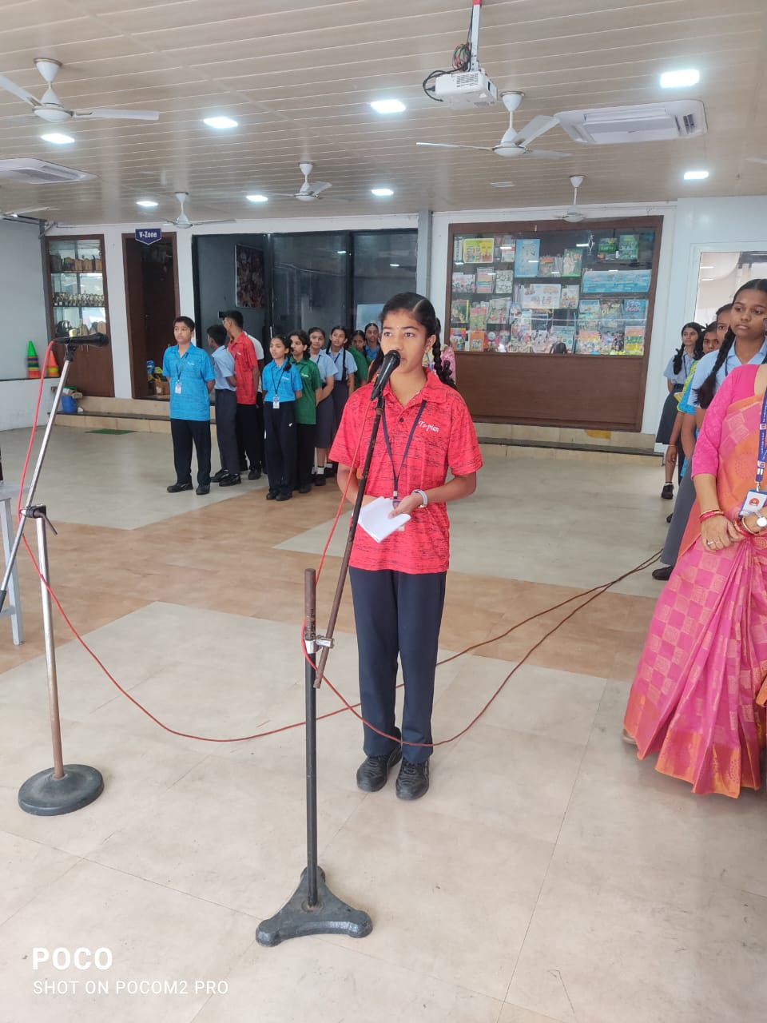
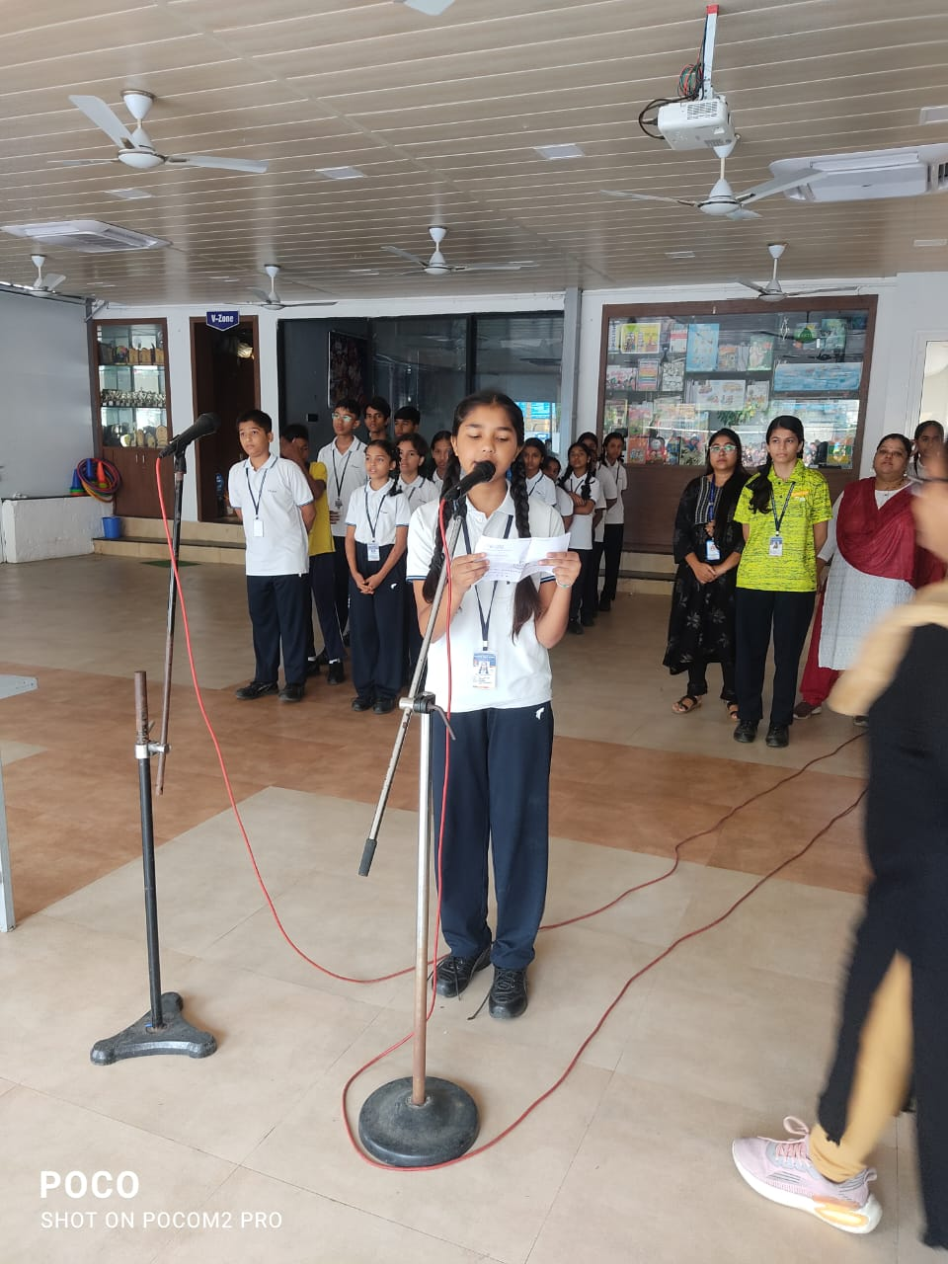
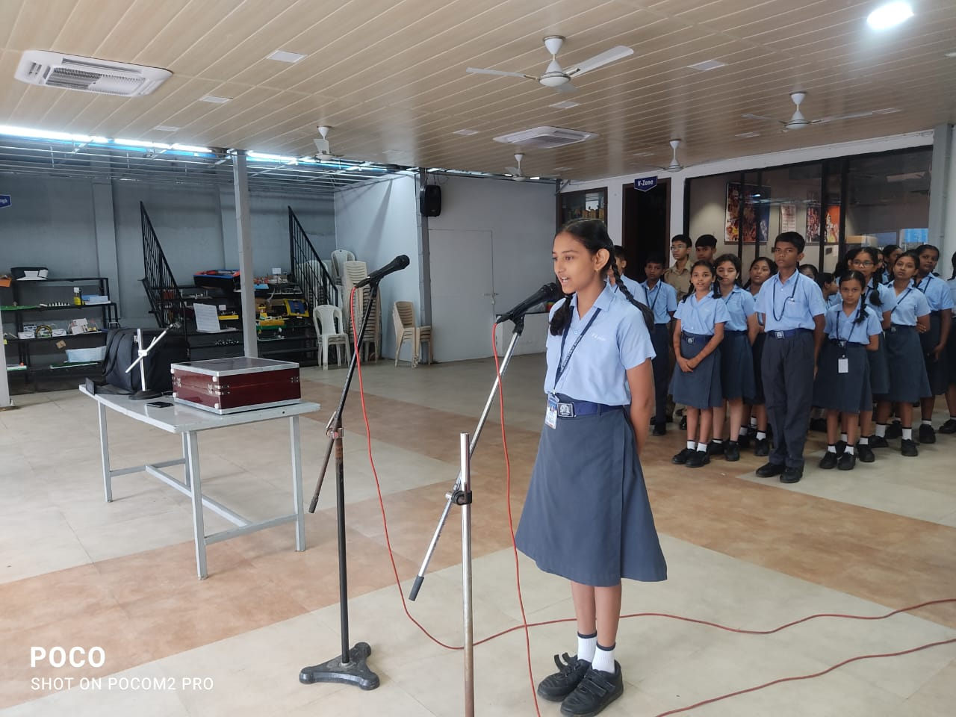
SPECIAL DAYS
Assembly… HINDI WEEK

Slide 23
SPECIAL DAYS
CELEBRATION OF
HINDI DAY

Slide 24
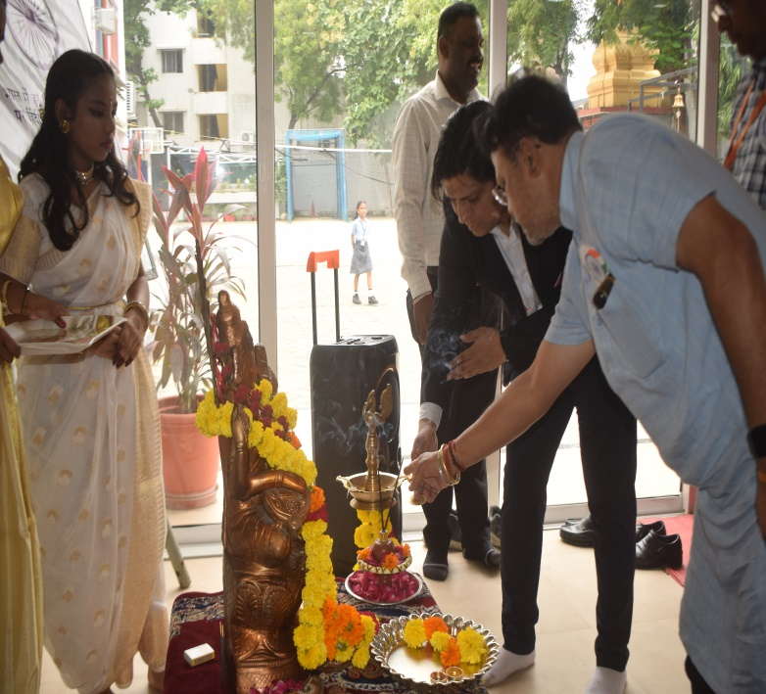
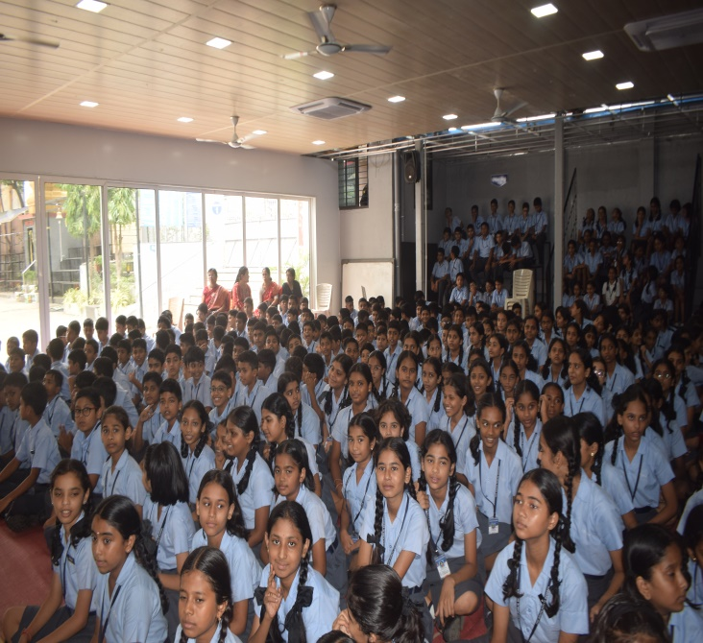
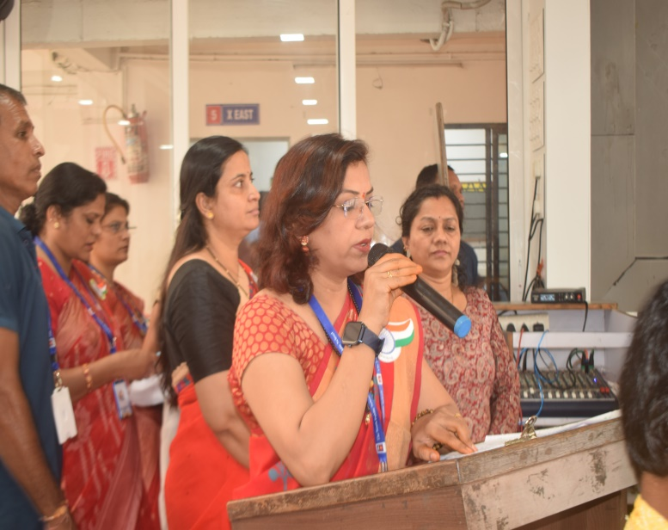
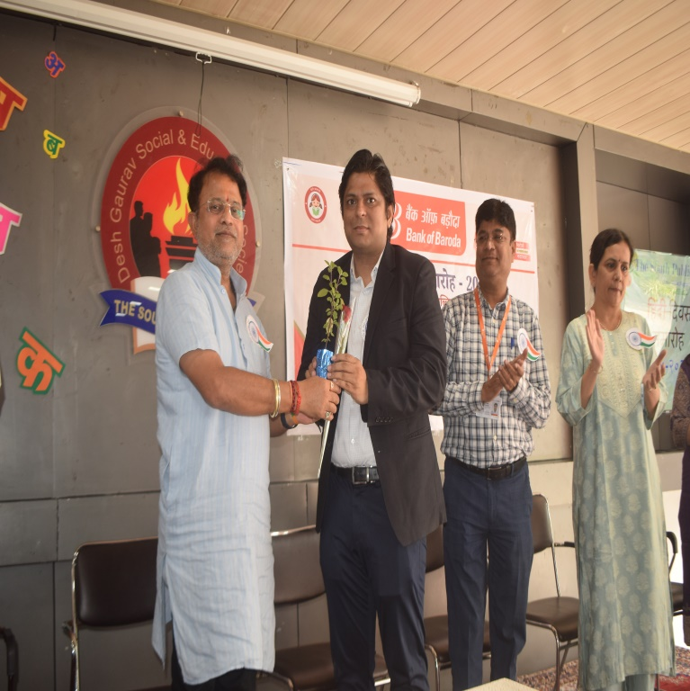
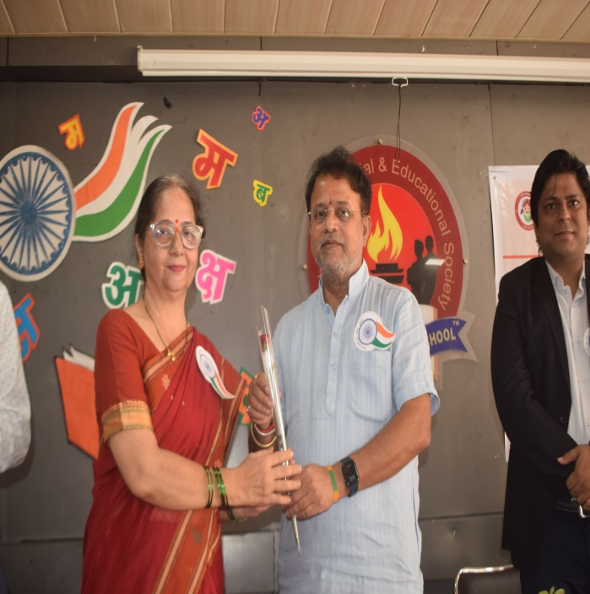
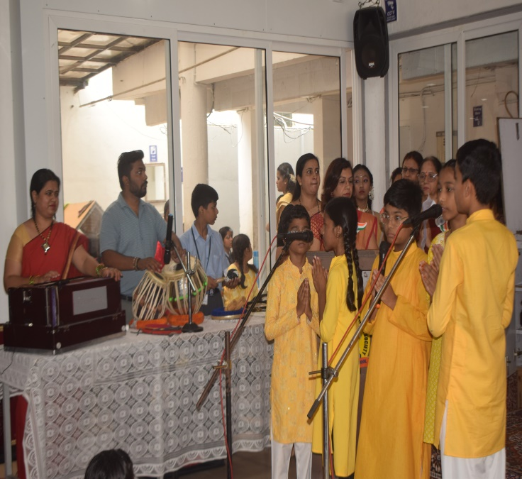

Slide 25
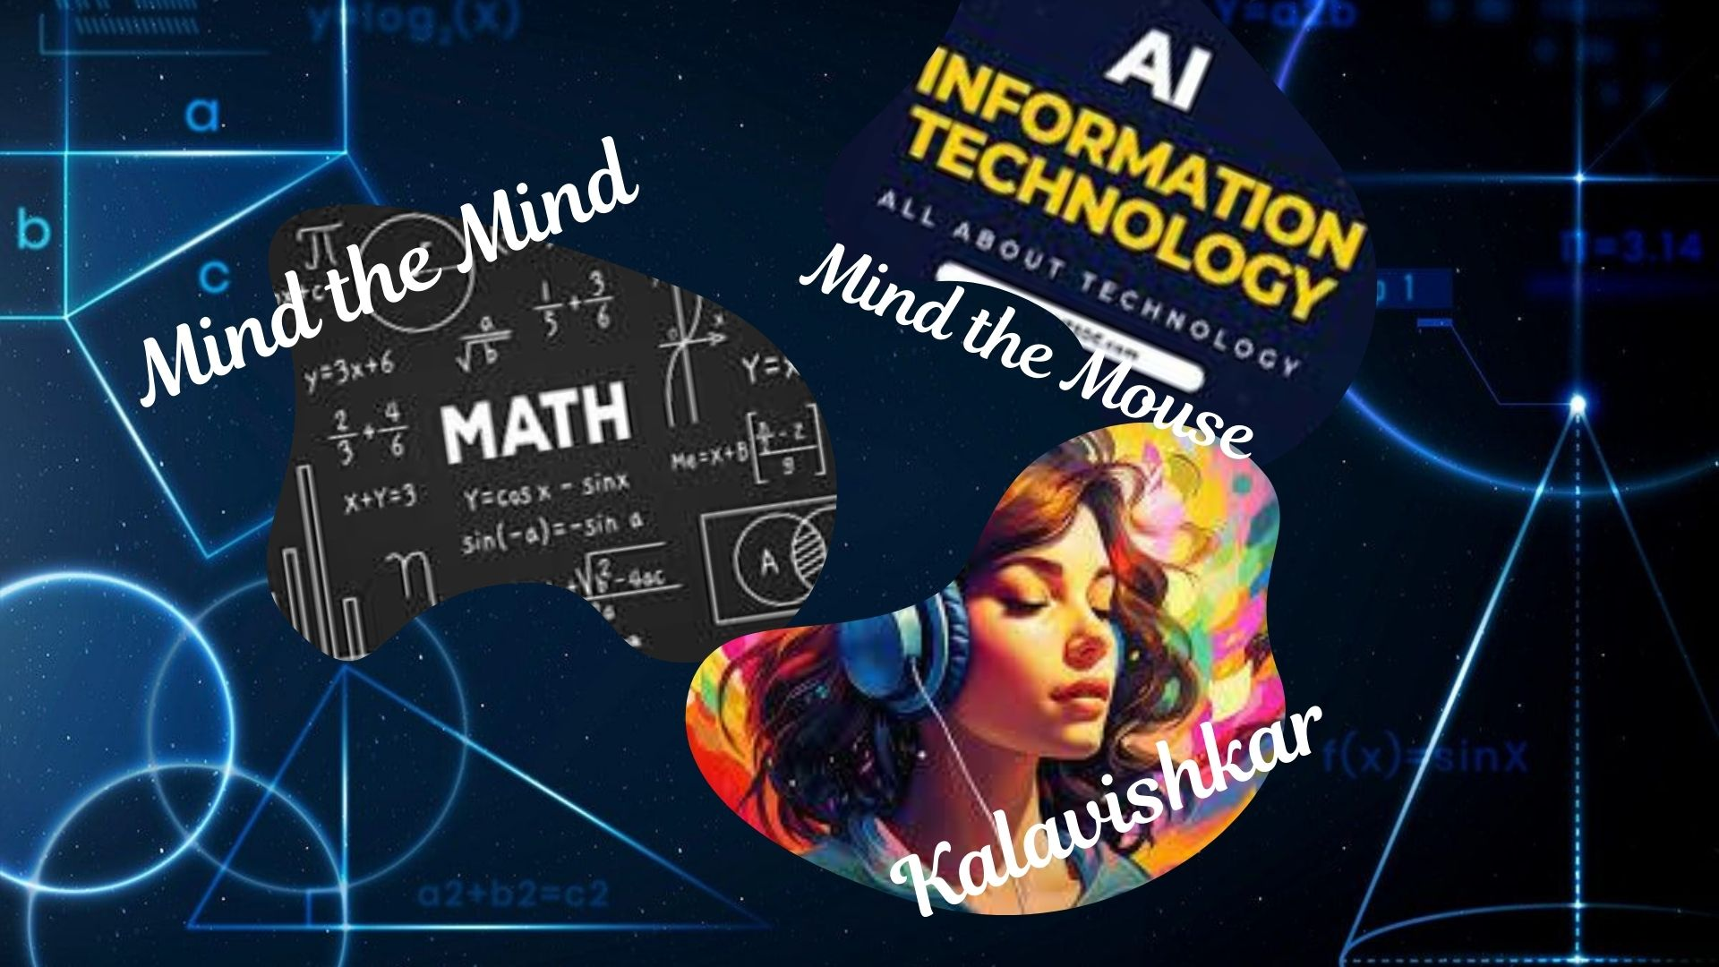

Slide 26

Celebrating Excellence at The South Public School: GEN Z FEST 2025
The South Public School recently celebrated GEN Z FEST 2025, a vibrant event that marked World Students' Day, observed on October 15th in honour of the birth anniversary of Bharat Ratna Dr. APJ Abdul Kalam, the former President of India.
The festival was a grand success, thanks to the efforts of the students, and the collaborative efforts of clubs Mind the Mouse , Mind the Mind and Kalaviṣhkar together with Cherry Blossom parents. The event featured an array of activities, including food stalls, live musical performances by Grade 10 students, and an impressive display of 75 models and 98 charts.
A record number of 260 students participated in the event, showcasing their talents and creativity. The judges for the event were prominent personalities, including Mrs. Shraddha Kelapure, former Headmistress of The South Public School, Mrs. Jayshree Deshmukh, former Supervisor and HOD- Science Department, and Mr. Vilas Ballamwar, retired Principal of Municipal Corporation Valmiki Nagar Secondary School. The Chief Guest, Dr. Shirish Ghan, appreciated the efforts of the students and the organizers, praising the event as a true celebration of talent and creativity. The Principal, Dr. Mrunalini Dasture, and the Director Shri Deaven Dasture, also lauded the participants for their enthusiasm and interest in the programme.The event was a resounding success, with the Vice Principal Mr Mangesh Chinewar, Coordinators, students, teachers, and parents alike appreciating the efforts put into making GEN Z FEST 2025 a memorable one.

Slide 27
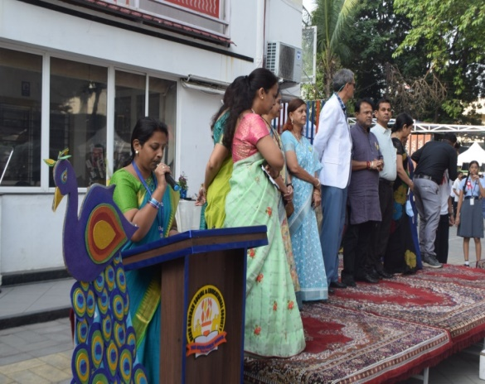
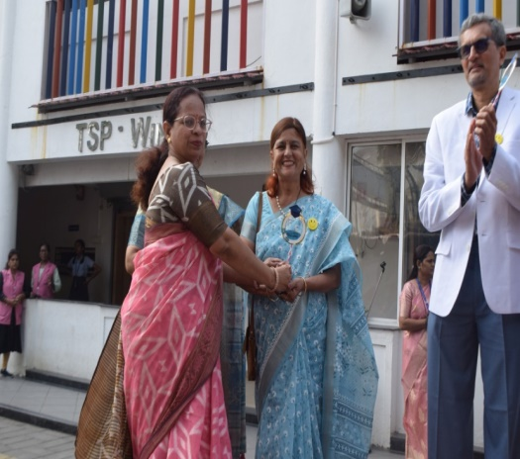
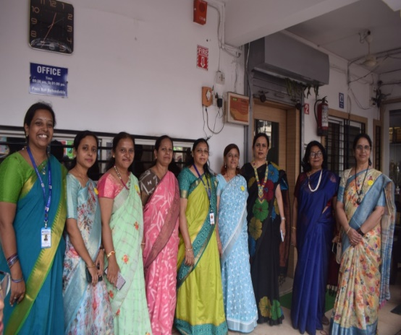
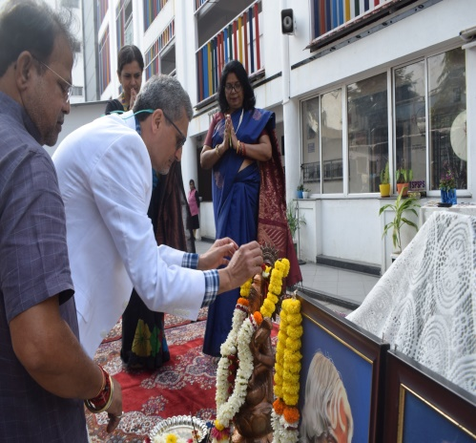
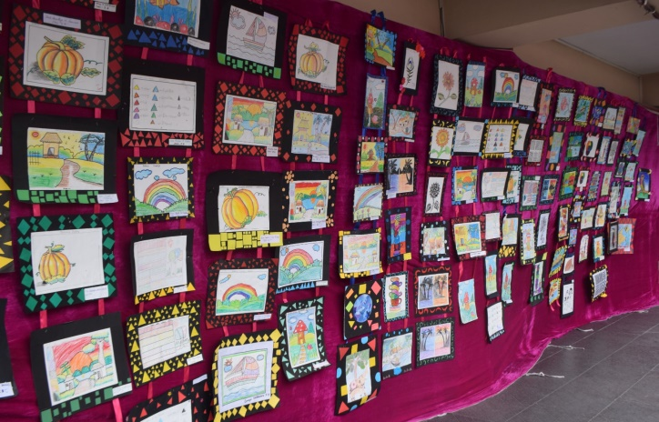
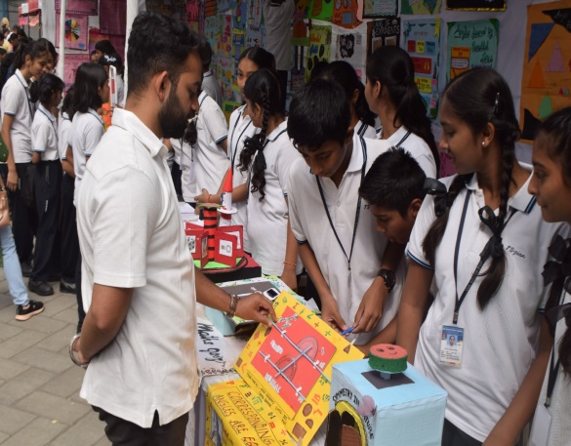
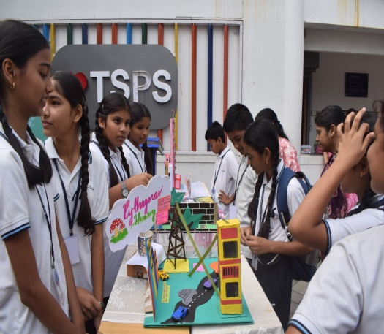

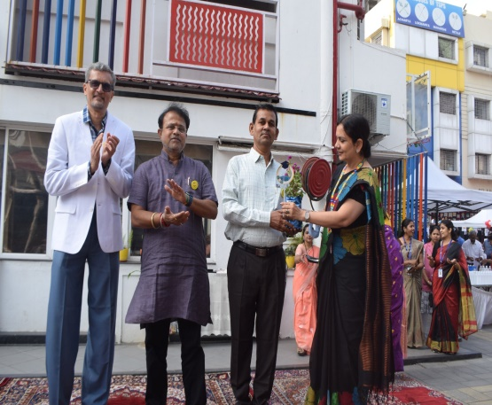
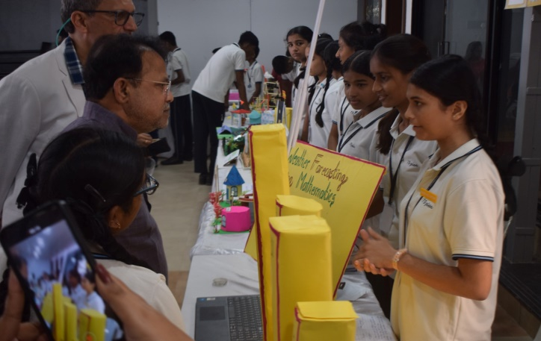



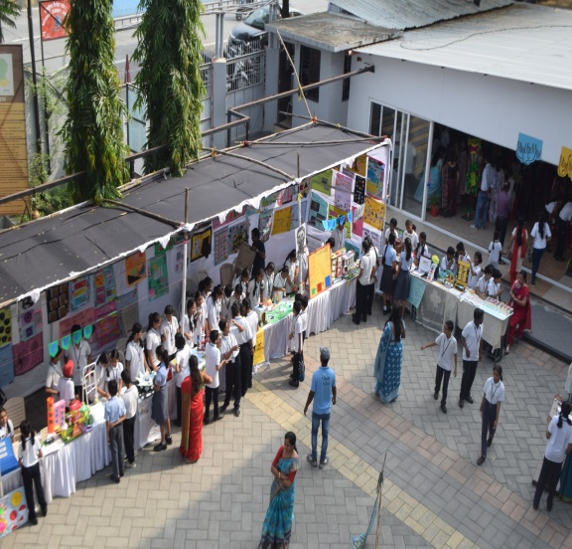
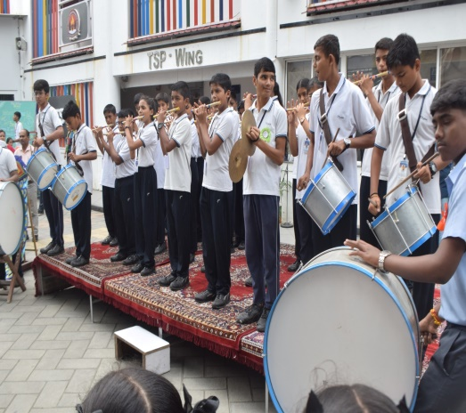
Celebrating Excellence at The South Public School: GEN Z FEST 2025 (Contd..)

Slide 28
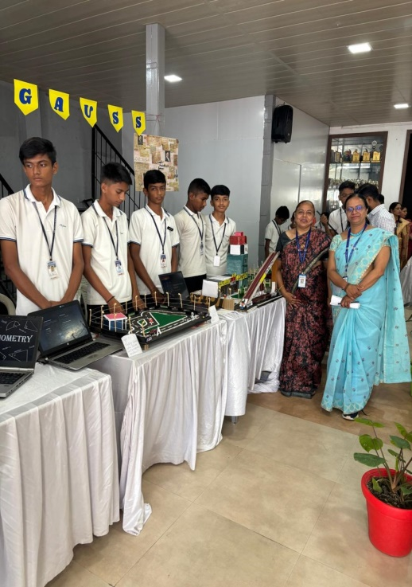
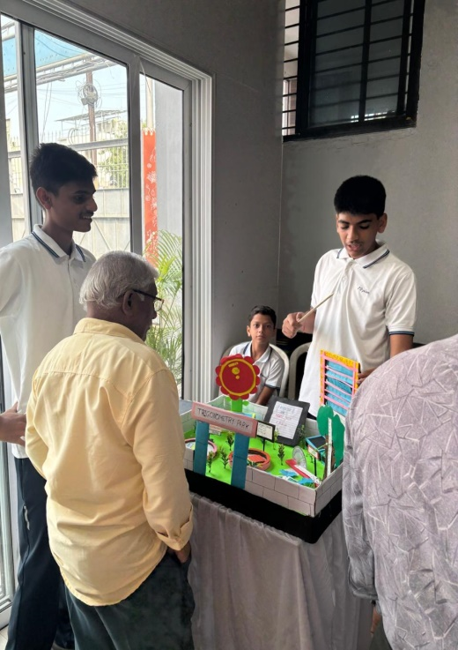
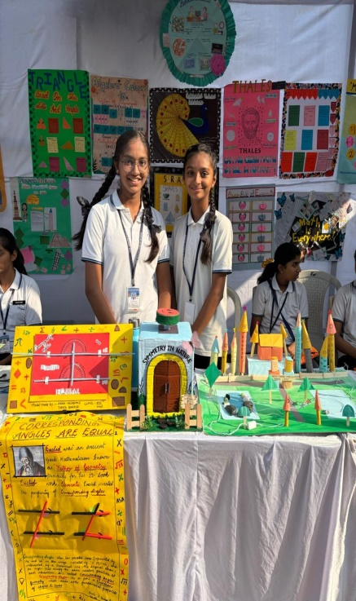







Celebrating Excellence at The South Public School: GEN Z FEST 2025 (Contd..)

Slide 29

School Event
BAG free children's day celebration for the classes 1 to 5
Day begins with assembly conducted by the teachers...news thought, given by the teachers ( acted as students)
melodious song sung by Music teacher Yamini ma'am with her dance moves...
special poem recited by Pathak ma'am written by her
Skit performance by 3 to 5 teachers...'types of students in a class‘
Dance performance by the teachers
Movie time- TOM AND JERRY * community lunch and cold cooking activity
HOUSE - WISE sports matches - Hurdle race
Happy end with all students on the dance beats Deaven sir, madam appreciated and motivated the students through their speech...

Slide 30






School Event
BAG free children's day celebration for the classes 1 to 5 (CONTD.)

Slide 31





School Event
Rotary Interact Club Activity
Donation of copies and pens to Upay Foundation

Slide 32
CCA ACTIVITY
Hindi Poem Recitation Competition
For grade 3 to 5
The South Point School recently conducted an Inter-House Hindi Poem Recitation Competition for students of grades 3 to 5.
The event, held on September 12, saw enthusiastic participation from students across different houses.
The competition featured ten diverse themes, including
"नदियों का जीवन" (Life of Rivers),
"सत्य की शक्ति" (Power of Truth),
"कड़ी मेहनत का महत्व" (Importance of Hard Work),
"सच्ची दोस्ती" (True Friendship),
"ईमानदारी एक ताकत है" (Honesty is Strength),
"रंगों का आनंद" (Joy of Colours),
"स्वतंत्रता सेनानियों की बहादुरी" (Bravery of Freedom Fighters),
"बचपन का आनंद" (Joy of Childhood),
"शिक्षकों का सम्मान" (Respect for Teachers), and
"शिक्षा का महत्व" (Importance of Education).
Through this competition, students showcased their poetic skills, creativity, and confidence. The event aimed to promote Hindi language and literature while instilling values such as honesty, hard work, and respect for teachers.
The South Point School congratulates all participants for their impressive performances and looks forward to more such engaging events in the

Slide 33






CCA ACTIVITY
Hindi Poem Recitation Competition
For grade 3 to 5

Slide 34






CCA ACTIVITY
BEST OUT OF WASTE

Slide 35



School Event
Ek Ped Maa Ke Naam
Dear Parents,
As per the Government’s initiative “Ek Ped Maa Ke Naam”, every student is required to participate by planting a sapling and dedicating it to their mother. To ensure proper documentation, the school requests you to kindly submit a clear photograph of your ward with the planted sapling.
Important Guidelines:
📌 The photograph must clearly show the child and mother along with the planted sapling.
📌 The photograph must be submitted to the class teacher on or before Monday i.e 6 October 2025.
📌 Submission is mandatory as per government instructions.
📌 We look forward to your cooperation in making this noble initiative a success and in nurturing a greener
tomorrow.

Slide 36


The South Public School’s ‘Read 'n' Grow’ Participation Report
The South Public School, celebrated recently took part in the Read 'n' Grow competition organized by Sandipani School. The event aimed at popularising reading habits among young learners.-
Structure: - Students were divided into different age‑group categories.
- Tasks included reading a selected book, and answering a written test covering character
sketches, plot points, and—for younger children—simple illustrations.
Participation - Our children took part with great enthusiasm and zeal. The results are still awaited.
Outcome & Benefits: Irrespective of the final results, the exposure to literature has already enriched
the students.
It is hoped that this experience will sharpen their reading skills and inspire many to become writers in the future. Congratulations to all participants and best wishes for the results!

Slide 37



A Day Exclusively For Men at TSPS!!
South Public School celebrated International Men's Day on Saturday, 22 November 2025, with a vibrant tribute to its 22 male staff members. A royal entry set the tone, as all 22 members made a grand, stylish entrance accompanied by rocking background music, instantly lifting the atmosphere. To welcome them, each staff member received a hand‑crafted greeting card. The program commenced with the National Anthem, honoring the collective contributions of the men who shape the school’s ethos. Yamini ma’am then filled the auditorium with melodious songs, delivering timeless classics like Mera Saya and Tu Hai To Dil Dhadakta Hai. This was followed by an energetic dance performance by Rutuja ma’am and Yamini ma’am, leaving the audience cheering. The female PTI teachers kept the excitement alive by conducting a series of fun games, while Mrunalini ma’am raised a toast with tomato soup, sharing laughter and good wishes. As a token of appreciation, beautiful mufflers were gifted to every male staff member. The celebration concluded with cake cutting and snacks, creating a warm, festive mood that reinforced the school’s gratitude and admiration for its male workforce.
School Event

Slide 38



In-House Training for Grade I – V teachers
School Event

Slide 39















A Day Exclusively For Men at TSPS!! (Contd.)

Slide 40





SAFAL EXAM
Structured Assessment for Analyzing Learning (SAFAL), a competency-based assessment as per there commendation of the National Education Policy (NEP) 2020 at para 4.40, was launched by CBSE in its affiliated schools in July, 2021. This computer-based assessment is designed to assess the students of Grades 5, and 8 in key competencies across core curricular domains of Language, Mathematics, and EVS/Science.
SAFAL Exam conducted in between 10th November to 2nd December 2025
School Event

Slide 41








Book Exhibition at Reshimbagh Ground
The South Public School's visit to the Book Exhibition at Reshimbagh Ground was a huge success! Students from 7th and 8th std. explored the diverse range of books on display, spanning fiction, non-fiction, academics, general knowledge, novels, competitive exams, literature, biographies, and more. The exhibition offered something for everyone, sparking curiosity and fostering a love for reading among the young minds. Hundreds of stalls showcased a vast array of books. Special discounts were available, and students got to meet authors from local to national levels. Wooden decorative items added to the cultural vibe, making the visit a memorable one.
School Event

Slide 42


Art
Mart

Slide 43

Literary
corner

Slide 44


Ma'am
Ma'am, you are my everyday hero.
I love you for all the ways you care.
You help me even when I fall down,
You are always kind and fair.
You fix my lunch, you tie my shoes,
You teach me right from wrong,
You cheer me and when I feel small,
You help me grow up strong.
You make me laugh when I feel sad,
You wipe away my tears.
You hold me close and help me feel safe,
Through all the years.
So here's a hug and here's a kiss,
And words I want to say,
Thank you so much Ma'am for being you,
I love you Ma'am
Gururaj Singh
Class 7B
Rakhi in the Digital Age
Raksha Bandhan is always been special to me. I remember making Rakhis with wool, beads and glitter, messy but full of love. My brother would laugh with the chaos but his smile when I tied it said everything. Now things are changing, some sisters send Rakhis online.
Some of them through video calls. Gifts are digital and hugs come with emojis but even in this new world love stays the same. Whether we are sitting next to each other or waving through a screen that one simple thread always still says- I'll always be there for you because real bonds don't need Wi-Fi.
Shruti Rahangdale
VIII W
English

Slide 45
Rain
Dear rain, come softly,
Don't create a mess.
Don't dirty the roads,
Don't rush into the houses.
There, look at the mess you made.
You've made the puddles all over.
You've brought the storm again,
You're very good at poking fun of earth's mortals.
Frail, crumbling doors,
Crumbling shutters,
Crumbling souls,
Crumbling lights,
Crumbling hearts.
And yet we still wait for you,
Your voice hums in the silence of longing.
Your scent, a memory we can't forget,
You ruin, but you renew.
You drown, but you cleanse.
Even broken things bloom when you are kind.
Shravani Khobragade
IX E
Memorable Day
One day, I was alone and I was thinking about an incident which happened and that incident made me smile. So let me tell you about it. In the morning, I was in a hurry to reach school, as I am in a senior class and it was our house's turn to present the assembly, and I walked as fast as I could. I reached up to midway to my route when I saw a kitten on the road. It was really small, brown and pink-coloured. I thought nothing; I just wanted to save her. So I ran to it, picked her up, and ran to the side of the road. I was satisfied with a high-pitched meow. But then I remembered my school, and I ran. I saw a cat mewing at the side; I thought she might be her mom, and I kept the kitten there, fully satisfied with saving the kitten's life. And I can't forget the small role I played in saving the kitten's life.
SPHURTEE MESHRAM
IX W
English

Slide 46
Diwali Through My Eyes
✨Diwali has come with sparkles and cheer,
The happiest time of the whole year..
Though my exams are right after the day,
I still light diyas in my own way..
The sky is glowing with colors so bright,
Crackers paint magic deep into the night.
Sweets on the table, laughter all around,
Peace and joy in every sound...
Mom decorates with rangoli’s art,
The glowing lamps warm every heart..
Friends drop by with sweets to share,
Smiles and blessings fill the air.
Books can wait for just one night,
For Diwali’s glow feels pure and right.
With hope and dreams that softly gleam,
I study tomorrow..with light in my dream.
Shravani Khobragade
IX E
English

Slide 47


Slide 48



Slide 49



Slide 50



Slide 52


STUDENTS SHOWCASE TALENTS AT PTM

Slide 53
Skit Presentations on the day of PTM from the class 5.... Grammar Court- English

Slide 54
Skit Presentations on the day of PTM from the class 5....
Fraction Birthday Party - Maths

Slide 55



achievements
2025-26

Slide 56

Teacher Achievements

Slide 57
Kiran rathod

Slide 58
Shilpa nandanpawar

Slide 59
Rajeshree kulkarni

Slide 60
The South Public School Achieves Success in Comic Strip Making Competition.
The South Public School has once again showcased the creative prowess of its students by securing the third prize in the Comic Strip Making Competition held during the 'SANMERAKI' event organized by MKH Sancheti School.The winning team consisted of talented students Yukta Chinchulkar and Varuni Deshmukh from Class VI A, along with Dimpi Krishna Nimje and Nandini Sharma from Class VI D. Under the guidance of the Arts Department, led by Mr. Tushar Sasankar, the students demonstrated exceptional artistic skills and creativity.
The Principal, Dr. Mrunalini Dasture, praised the efforts of the students, acknowledging their hard work and dedication. This achievement reflects the school's commitment to nurturing the artistic talents of its students and providing them with opportunities to excel in various fields. Congratulations to the students and the Arts Department on this well-deserved recognition!

Slide 61




Slide 62
Students
Achievements

Slide 63




BUDDING SCIENTISTS WIN LAURELS
South Public School feels immense pride in sharing that Mast. Naksh Rathod (5B) and Mast. Jeevansh Pathode (5D) have clinched the 2nd Runner‑up position at the Vigyan Yatra science‑model competition, organized by Bhavan’s Aashti School. Their innovative project stood out among many entries, earning them this distinguished achievement and bringing laurels to the school. Hearty congratulations to the young scientists and their mentors!

Slide 64


A young author from Class IV B, Mast. Tanmay Kamble of The South Public School at a very young age of just 9, has written a wonderful book titled Rory and the Queen. With the support of his parents, who helped him publish the book and guided him in correcting grammatical errors, he has successfully completed this impressive work. It is truly appreciable and inspiring for the young generation to see such talent and creativity at an early age. The book is available through Bri- Publication.
Miss Dhara Zha from class 4th B secured third position in स्वर्गीय गिरिजाबाई शेळके स्मृती आंतरशालेय कथा कथन स्पर्धा felicitated with a certificate and a cash prize of Rs. 500

Slide 66
We are delighted to share that Mast. Aniket Kolhekar of Grade V brought laurels to our school by securing the First Prize in the “साभिनय काव्य प्रस्तुती” competition. The prestigious event was organized jointly by Maharashtra Rashtra Bhasha Sabha and Maharashtra Bal Rangabhoomi Parishad in Nagpur.
Amongst 45 talented participants from across Maharashtra, Aniket’s outstanding performance earned him the top position. This remarkable accomplishment is indeed a moment of great pride for the school as well as for his parents.
We wholeheartedly congratulate Aniket for his dedication and success.

Slide 67



Debate Competition Winners
We are proud to announce that our students, Avni Lakhe and Akanksha Jhade, participated in the "Alankrit Rajbhasha Gaurav" Debate Competition organized by Mount Litera Zee School.
Both students showcased their exceptional debating skills and were awarded consolation prizes. They received certificates and a cash prize of Rs. 500 each. The school congratulates both students on their achievement and wishes them continued success in their academic pursuits. Well done, Avni and Akanksha!

Slide 68



"Gold‑Medal Moment for Swara Thackeray”
Swara Thackeray, a 7th‑grader ,etched her name in the school’s sports history by clinching the gold medal in skating at the Lokmat Maha Games, organized by Lokmat.
The school management and faculty congratulated Swara,praising her commitment and sportsmanship. Her achievement is a shining example that with hard work and perseverance, success is inevitable. We wish Swara many more victories and a glittering future ahead!
✨ Falguni Pimpalghare, a 4th-grade student of our school, has won a bronze medal in Archery competition at the Lokmat Maha Games, organized by Lokmat.✨

Slide 69

"Chaitanya Kalli of VIII E did his alma mater proud when he won first prize in the 'My Favourite Soldier' elocution competition, held under the auspices of Tejachi Aarti Abhivyakti and graced by Vice Admiral Honorable Shri Kishore Thakre.We wish him all the best in his future endeavours.
"Gold‑Medal Moment for Swara Thackeray”
Swara Thackeray, a 7th‑grader ,etched her name in the school’s sports history by clinching the gold medal in skating at the Lokmat Maha Games, organized by Lokmat.
The school management and faculty congratulated Swara,praising her commitment and sportsmanship. Her achievement is a shining example that with hard work and perseverance, success is inevitable. We wish Swara many more victories and a glittering future ahead!

Slide 70



🌟 Proud Moment for THE SOUTH PUBLIC SCHOOL( TSPS)! 🌟
Students of our school excelled at the Kickboxing Championship 2025, organised by the Sports Kickboxing Association of Nagpur.🥇 Gargi Shete (3D) – Gold in Point Fight & Gold in Team Event
🥇 Vaidehi Shete – Gold in Point Fight & Gold in Team Event
🥇 Riddhi Dhonge (5B) – Gold in Point Fight, Gold in Creative Form Weapon & Gold in Creative Form
🥇 Vrushank Dhonge (5D) – Gold in Point Fight, Gold in Simple Creative & Silver in Team Event
Our young champions have brought great laurels to TSPS!Heartiest congratulations to all! 🎉💐

Slide 72

Dear Readers,
As we ring in the first edition of TSPS Bytes for the session 2025-2026, we reflect on the joy and creativity that has gone into making it a reality. Our students' efforts have shone through in every page, and we're thrilled to share their talents with you.
Our next edition is just around the corner, scheduled for release in early November. We can't wait to showcase more of our students' work and share their stories with you!
As we continue to grow and improve, we value your inputs. Please share your thoughts and suggestions with us, and help us make TSPS Bytes an even better reflection of our school's spirit.
As the festive season approaches, we wish you and your loved ones a time of joy, love, and celebration. May the festivals of Dussehra and Diwali illuminate your path and fill your heart with happiness.
Best regards,
Team TSPS Bytes

